Slide 1
Interaction Level Prediction with Ego-centric Lifelogs
25/06/2021
Zhang Chen
Notes:
Good afternoon everyone. I’m Zhang Chen from SCC. Today I’m presenting on a project I’ve been working on recently. The title of my talk is Interaction level prediction with ego-centric lifelogs.

Slide 2
Group Members
Vigneshwaran Subbaraju, SCC
Thivya KANDAPPU, SMU
Vuong Dao Nghe (Thomas), SCC
Lai Ying, SCC
Chen Zhang , SCC
Pramath Krishna (Student), SCC
Notes:
First of all, I’d love to introduce my group members. They are Vignesh, Thivya, Ying, Thomas, me and Pramath. I’d like to thank Vignesh and Thivya for their guidance, Ying Lai and Thomas for their hard work. And special thanks to Pramath. Although he hasn’t started his undergraduate study yet and is just doing internship here, he has done a great work in idea generation and experiments. He has also helped me a lot while I’m preparing the slides.

Slide 3
Agenda
Project application
Dataset description
Annotation procedure
Proposed model
Thoughts and conclusions
Notes:
The agenda for today is as follows: firstly I’ll share about some motivations and goals of our project and potential applications. Then I’ll introduce our R3 dataset and show some statistics of it. We have also finished a rigorous annotation exercise recently and I’d like to explain our annotation procedure. Next I’ll showcase our proposed model architecture and share some alternative models as ablation study.

Slide 4
Project Application
Interaction level as a marker for psychiatric disorders:
Monitor daily activities of the elderly and track the changes in their social interaction levels.
Detect any unusual sudden changes (e.g. HIGH -> NO) as an early sign of dementia.
Function as an organized photo album for the elderly to check regularly and refresh their memories.
Notes:
My team wants to use interaction level as a marker for psychiatric disorders. Hopefully, by monitoring daily activities of the elderly and track their changes in interaction levels, we can detect any unusual sudden changes. For example from H to N, meaning that the elderly might have forgotten the person. This can be used as an early sign of dementia.
Meanwhile, we hope our algorithm can function as an organized photo album for the elderly to check regularly and refresh their memories.

Slide 5
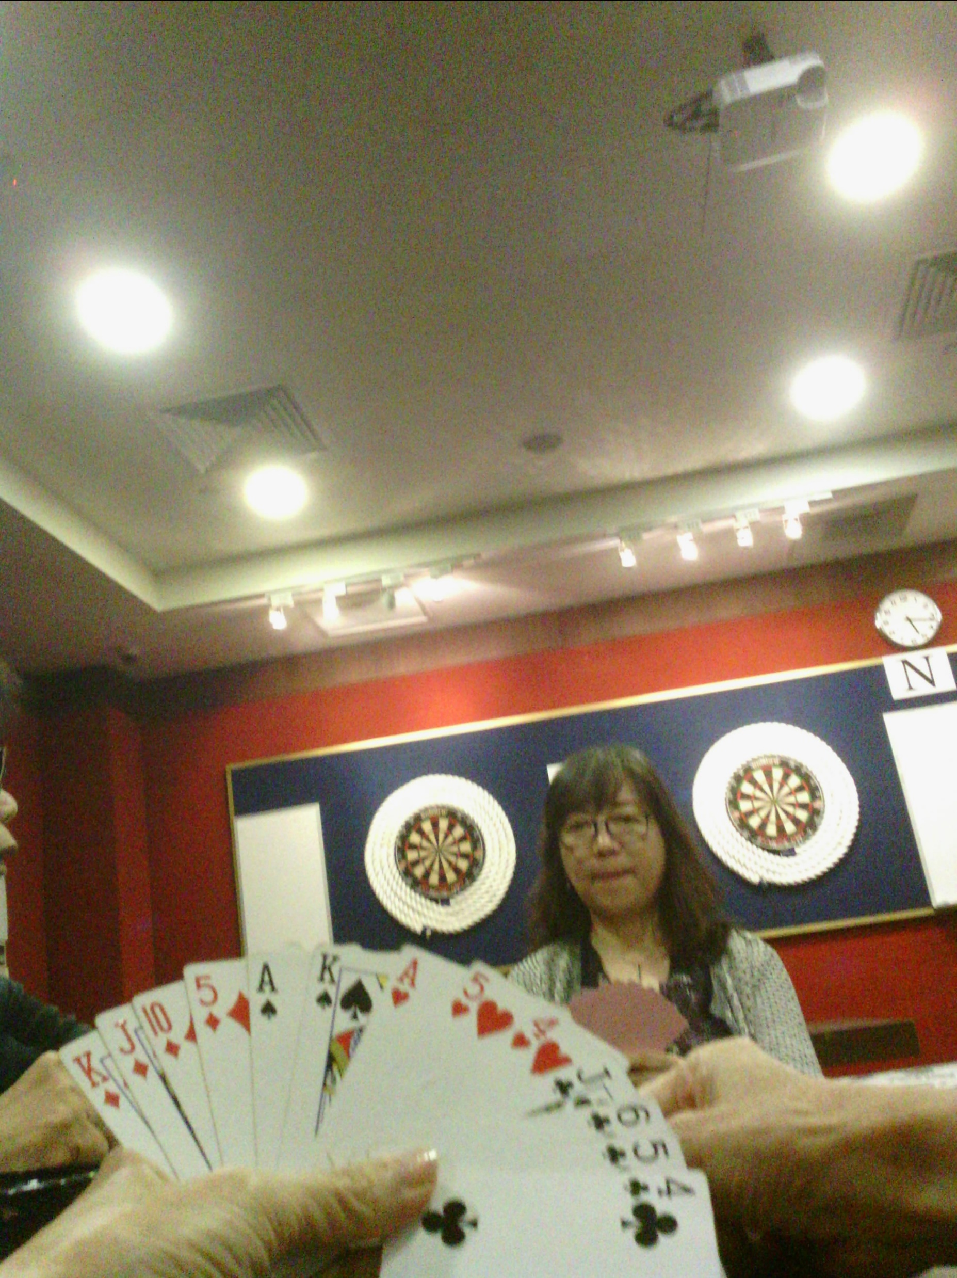
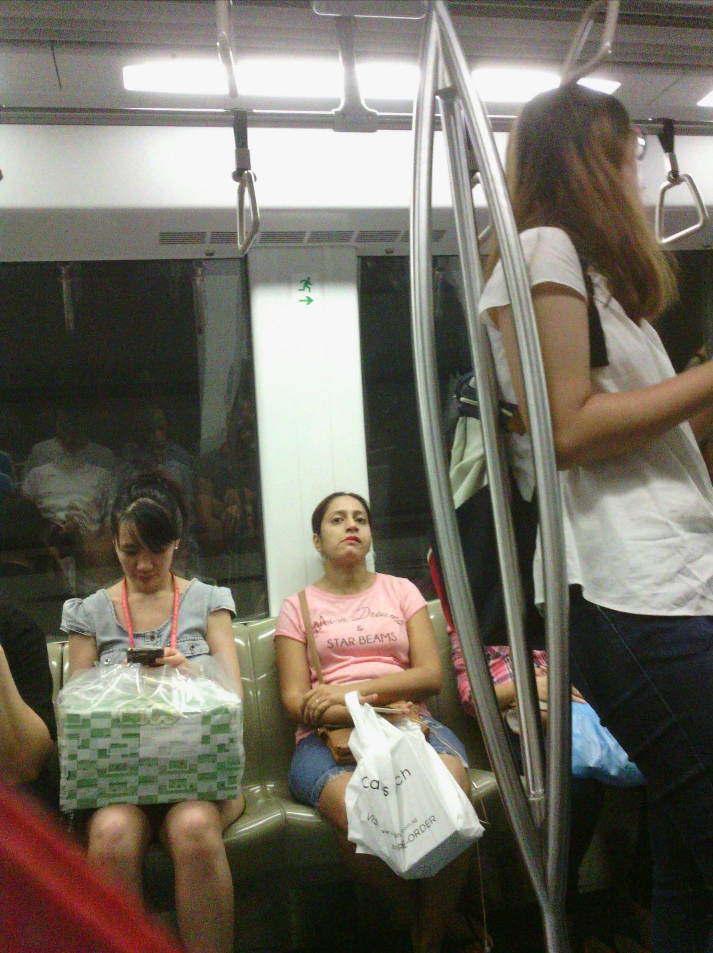

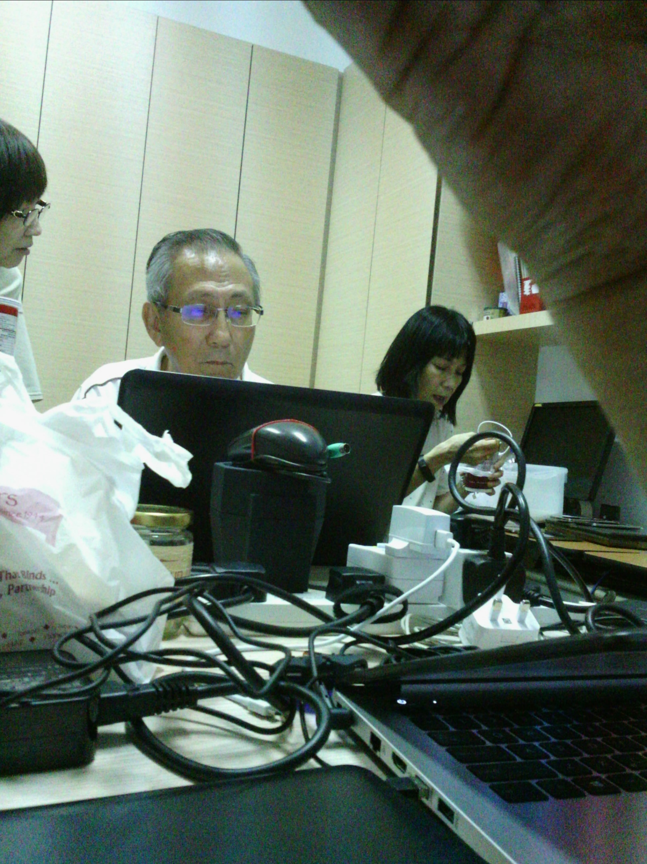
Dataset Description
R3 (Record, REtrieve and REplay) Dataset.
Consists of photo streams captured at 2 fpm by an ego-centric camera at chest level while the camera wearer (CW) performs their daily routines.
Captures a wide variety of activities (eating, meeting, etc.) and scenes (transportation, library, food court, etc.)
Each CW interacts with hundreds of people making the dataset rich and challenging.
Notes:
The dataset we are working on is called R3 (Record, Retrieve and Replay) dataset. It was collected by Vignesh and his colleagues back in 2017 and contains 40+ lifeloggers’ data. It consists of photo streams captured at 2 fpm by an ego-centric camera at chest level while the camera wearer continues their daily activities. As can be seen from the examples on the right, the dataset captures a wide variety activities such as eating and meeting, as well as social scenes like transportation, library, casino, food court etc. Each CW also interacts with hundreds of people. All of these make the dataset very rich while challenging.

Slide 6
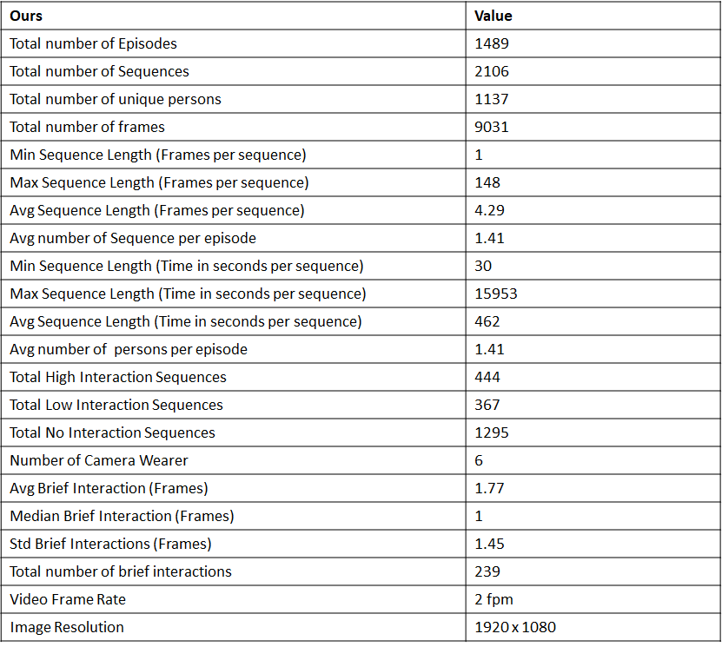
Dataset Statistics
Annotation done for 6 CWs
Length of sequence varies greatly:
Min: 1 frame
Max: 148 frames
Class distribution is skewed
Frame rate is 2 fpm, traditional face tracking models fail on our dataset.
Notes:
Here are the statistics of the annotated portion of our dataset. We completed the annotation for 6 camera wearers in total. And as we can see from the numbers, the length of sequence varies greatly, from the minimum of 1 frame to the maximum of 148. Meanwhile, the class distribution is also a bit skewed, so we did some oversampling while during data loading to take care of that. The frame rate is 2 fpm which is quite low. Thus, normal face tracking algorithms don’t work well with our dataset, so we designed an intuitive but effective pipeline for face tracking.

Slide 7
Annotation Details
Annotation is done internally by 6 team members. Each CW’s photos are labelled by 2 annotators and a third annotator for the tie cases.
Used VGG Image Annotator (VIA) developed by Visual Geometry Group at Oxford for our annotation.
Given a sequence of frames, the annotator should label the interaction level for each person who has appeared in the sequence.
The annotator should also select attributes present in the sequence and the reasons (attributes that are important) why they choose the label.
The attributes and reasons serve as supervision for our model training. They can also help the CV community develop semantically meaningful models with better reasoning capability and interpretability.

Slide 8
High Interaction
Definitions for Labels
Low Interaction
No Interaction
No social group
No direct contact and may have only a brief indirect engagement
Not looking in the general direction of camera wearer majority of the time
Indifferent to the others’ activity (i.e Strangers)
lack of elevated emotions
Mutual focus of attention
Must face to face engagement/ conversation
Active participation of camera wearer
Show of elevated emotions
Evidence of social group (Formation)
Can have brief direct engagement or look in the general direction
Passive participation
lack of elevated emotions
Notes:
To guarantee the standard of our annotation. The first step is to come up with a consistent set of definitions for interaction levels. Here are the definitions we used. For the sake of time, I won’t explain them in details.

Slide 9
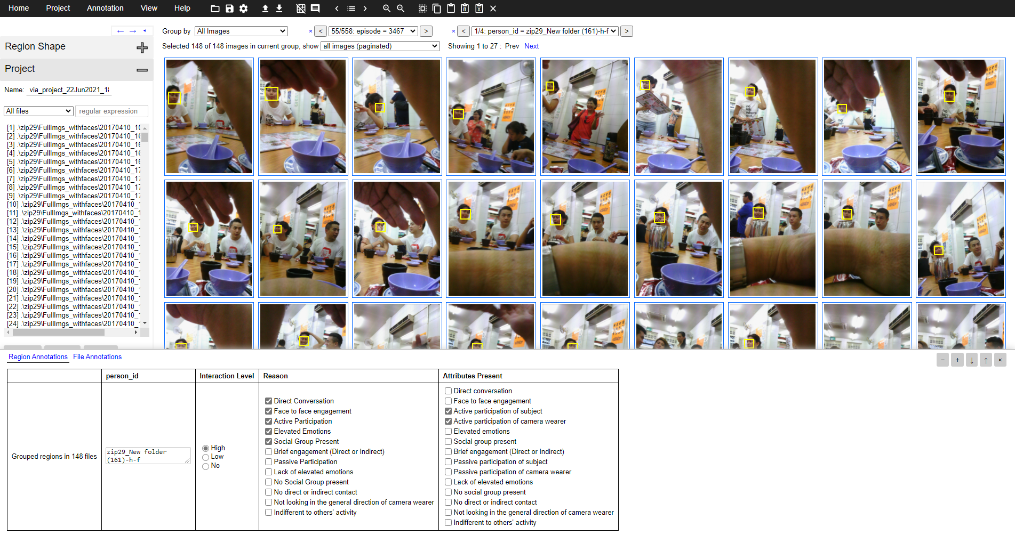
1
2
1- Click < or > to go to the next sequence
2- Click < or > to go to the next person in the same sequence
Once all individuals in the same sequence is labelled, go to the next sequence by clicking > on shot (1)
Notes:
Here’s a screenshot of VIA software. In the center we can see all the frames of a sequence. The annotator will look through the frames and select the interaction level, reasons to choose the label, and attributes present down here. After that, the annotator can navigate to the next person in the episode.

Slide 10
Effectiveness of Attributes/Reasons
To show that the reasons collected are predictive. An 1-layer linear classifier is trained with reasons as input features and the interaction level as output.
The model is trained with data of 4 CWs and tested on 1 CW. The results are impressive given the simplicity of the model.
This inspires us to create a model that first detects these attributes then combines them dynamically for interaction level classification.
 | Test Accuracy | Precision | Macro Avg Precision | Recall | Macro Avg recall | F1 | Weighted F1
1 | 99.0 | [0.967, 1.0, 0.994] | 0.987 | [0.986, 0.964, 1.0] | 0.984 | [0.976, 0.982, 0.997] | 0.990
2 | 99.0 | [0.967, 1.0, 0.994] | 0.987 | [0.986, 0.964, 1.0] | 0.984 | [0.976, 0.982, 0.997] | 0.990
3 | 99.0 | [0.967, 1.0, 0.994] | 0.987 | [0.986, 0.964, 1.0] | 0.984 | [0.976, 0.982, 0.997] | 0.990
Avg | 99.0 | - | 0.987 | - | 0.984 | - | 0.990
Notes:
To examine the effectiveness of the reasons we collected. We trained a 1-layer linear classifier using reasons as input and interaction level as output. The model is trained with the data of 4 CWs and tested on 1 CW. The results are shown below， which are quite impressive given the simplicity of the model. This result inspires us to create a multi-modal fusion model that first detect these attributes then combines them dynamically for the final classification.

Slide 11
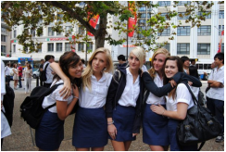
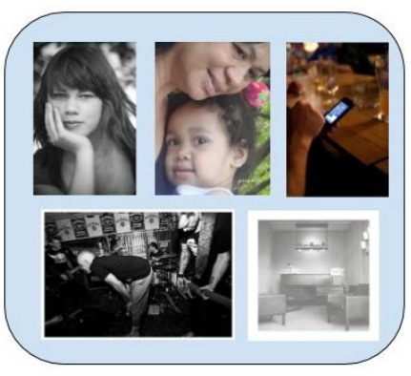


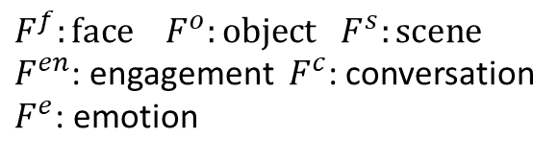


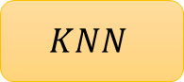















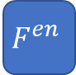
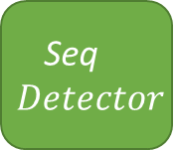
Proposed Model Architecture
$F^{f}:face$ $F^{o}:object$ $F^{s}:scene$
$F^{en}$: engagement ${ F}^{c}$: conversation
$F^{e}$: emotion
Modals
Conversation (Binary)
Engagement (Binary)
Participation (Active, Passive, Indifferent)
Emotions (Binary)
Social Group (Binary)
Duration (Brief) (Is it more than a frame count?)
Interaction level (H, L, N)
For each face sequence
$$Interaction Classifier$$
Output ground truth: reasons
Input ground truth: attributes present
$$F^{e}$$
$${RNN}^{e}$$
$${CS}^{e}$$
Competence classifier
Neighborhood
(Episode Level)
$$F^{c}$$
$${RNN}^{c}$$
One-hot
attributes
$${RNN}^{e}$$
$$F^{e}$$
$${CS}^{c}$$
CC
Ep 1
Ep 2
Ep 3
Seq$Detector$
$$F^{en}$$
$${RNN}^{en}$$
$${RNN}^{c}$$
$$F^{c}$$
$${CS}^{en}$$
Frame-wise
features
Attribute
classifier
$${RNN}^{en}$$
$$F^{en}$$
Ep 4
…
Competence score
$$F^{f}$$
Latent vector for each seq per episode
$$F^{o}$$
$$LSTM Auto$$
$$KNN$$
1 Latent vector per episode
$$F^{s}$$
Raw Input frames
(Episodes)
Notes:
Here’s our proposed model architecture. Given an episode of raw input frames, we first run it through a sequence detector to split into person sequences. Then our model splits into two branches. The first is sequence-level branch, we use pretrained CNN models to extract frame-wise features from the sequence. Here we have 3 modalities, which are emotion, conversation, and engagement level. These features are fed into an RNN-based classifier to detect attributes present in the sequence. Another branch is context or scene branch. We extract face, object and scene features with pretrained CNNs from the episode and compress them into a latent vector using LSTM autoencoder. This episode-level laten vector is then used to locate the neighbors in the database based on cosine similarity. From the neighborhood, one can tell that under certain scenarios, some attributes have higher significance (or more competent) in predicting the interaction level. And this difference is captured by dynamic weights (i.e. competence scores) generated by a competence classifier. The input to this competence classifier is the latent representation of each sequence in the neighborhood together with the attributes present in the sequence. It’s trained with supervision from attributes present and reasons (attributes that are important) pairs, which is part of our annotation. Lastly, the competence score and detected attributes are fused through dot product and fed into linear classifier for final output.

Slide 12




Proposed Model Architecture
$F^{f}:face$ $F^{o}:object$ $F^{s}:scene$
$F^{en}$: engagement ${ F}^{c}$: conversation
$F^{e}$: emotion
Modals
Conversation (Binary)
Engagement (Binary)
Participation (Active, Passive, Indifferent)
Emotions (Binary)
Social Group (Binary)
Duration (Brief) (Is it more than a frame count?)
Interaction level (H, L, N)
For each person sequence
$$Interaction Classifier$$
Output ground truth: reasons
Input ground truth: attributes present
$$F^{e}$$
$${RNN}^{e}$$
$${CS}^{e}$$
Competence classifier
Neighborhood
(Sequence Level)
$$F^{c}$$
$${RNN}^{c}$$
One-hot
attributes
$${RNN}^{e}$$
$$F^{e}$$
$${CS}^{c}$$
CC
Ep 1
Ep 2
Ep 3
$$F^{en}$$
$${RNN}^{en}$$
$${RNN}^{c}$$
$$F^{c}$$
Seq$Detector$
$${CS}^{en}$$
Frame-wise
features
Attribute
classifier
$${RNN}^{en}$$
$$F^{en}$$
Ep 4
…
Competence score
$$F^{f}$$
Latent vector for each seq
$$F^{o}$$
$$LSTM Auto$$
$$KNN$$
1 Latent vector per episode
$$F^{s}$$
Raw Input frames
(Episodes)
Notes:
Here’s our proposed model architecture. Given an episode of raw input frames, we first run it through a sequence detector to split into person sequences. Then our model splits into two branches. The first is person branch, we use pretrained CNN models to extract person-specif frame-wise features from the sequence. Here we have 3 modalities, which are emotion, conversation, and engagement level. These features are fed into an RNN-based classifier to detect attributes present in the sequence. Another branch is context or scene branch. We extract face, object and scene features with pretrained CNNs from the episode and compress them into a latent vector using LSTM autoencoder. This episode-level laten vector is then used to locate the neighbors in the database based on cosine similarity. From the neighborhood, one can tell that under certain scenarios, some attributes have higher significance (or more competent) in predicting the interaction level. And this difference is captured by dynamic weights (i.e. competence scores) generated by a competence classifier. The input to this competence classifier is the latent representation of each sequence in the neighborhood together with the attributes present in the sequence. It’s trained with supervision from attributes present and reasons (attributes that are important) pairs, which is part of our annotation. Lastly, the competence score and detected attributes are fused through dot product and fed into linear classifier for final output.

Slide 13
Model Description
Split a raw episode (containing multiple people) into sequences (focusing on only one person) with “Seq Detector”, since our prediction is done on sequence level.
Two branches: a sequence-level branch aims to produce person specific attributes such as conversation, emotion, and engagement level. And a episode-level branch to capture the context or scene information.
The episode-level branch is used to generate a neighborhood from the database by computing the cosine similarity on a latent representation obtained through an LSTM Autoencoder.
The neighbors show that under certain scenarios, some attributes have a higher significance. This weight (competence score) is dynamically generated by a competence classifier (CC).
The competence classifier is trained with supervision from attributes present and reasons (attributes that are important) pairs, which is part of our annotation.
The competence score and detected attributes are fused through dot product and fed into linear classifier for final output.

Slide 14


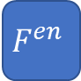





Model Variant 1
For each face sequence
$$F^{e}$$
$${RNN}^{e}$$
Interaction level (H, L, N)
$$F^{c}$$
$${RNN}^{c}$$
One-hot
attributes
$$Interaction Classifier$$
Seq$Detector$
$$F^{en}$$
$${RNN}^{en}$$
Frame-wise
features
Attribute
classifier
Remove the neighborhood, try to predict interaction level from detected attributes and a interaction classifier with fixed weights.
Raw Input frames
(Episodes)
Notes:
We also want to experiment with some model variants as ablation study. The first variant is quite straightforward. We removed the entire neighborhood branch and try to predict interaction level from attributes present with a fixed weight matrix. By doing so, we can examine the importance of context information and the idea of neighborhood.

Slide 15

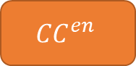


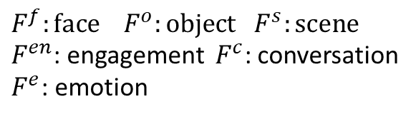
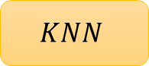







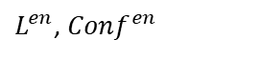



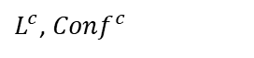


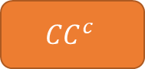




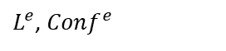


Model Variant 2
$F^{f}:face$ $F^{o}:object$ $F^{s}:scene$
$F^{en}$: engagement ${ F}^{c}$: conversation
$F^{e}$: emotion
For each face sequence
Interaction Class (H, L, N)
$$F^{e}$$
$${RNN}^{e}$$
$L^{e}$, ${Conf}^{e}$
Competence classifier
$${CS}^{e}$$
$${CC}^{e}$$
$${RNN}^{e}$$
$$F^{e}$$
$$F^{c}$$
$${RNN}^{c}$$
$L^{c}$, ${Conf}^{c}$
$$F^{p}$$
$${RNN}^{en}$$
$L^{en}$, ${Conf}^{en}$
$${CS}^{c}$$
$${CC}^{c}$$
$${RNN}^{c}$$
$$F^{c}$$
Seq$Detector$
Base
classifier
$${CS}^{en}$$
$${CC}^{en}$$
$${RNN}^{en}$$
$$F^{p}$$
Neighborhood
(Episode Level)
$$F^{f}$$
Competence score
Base
classifier
$$F^{o}$$
$$LSTM Auto$$
$$F^{s}$$
$$KNN$$
Raw Input frames
Latent vector
Notes:
The second variant appear to be quite similar to the proposed model at first glance. But they are different in terms of base classifier as well as competence classifier. In the proposed model, we used the ground truth attribute and reason annotations to train the competence classifier. But here we want to try an unsupervised approach. Previously, the RNNs or base classifiers predict attributes present in the sequence. But here we assume each modality alone is competent enough to directly predict the interaction level. And instead of a single competence classifier to generate a weight matrix, now we have three competence classifiers, one for each modality.

Slide 16
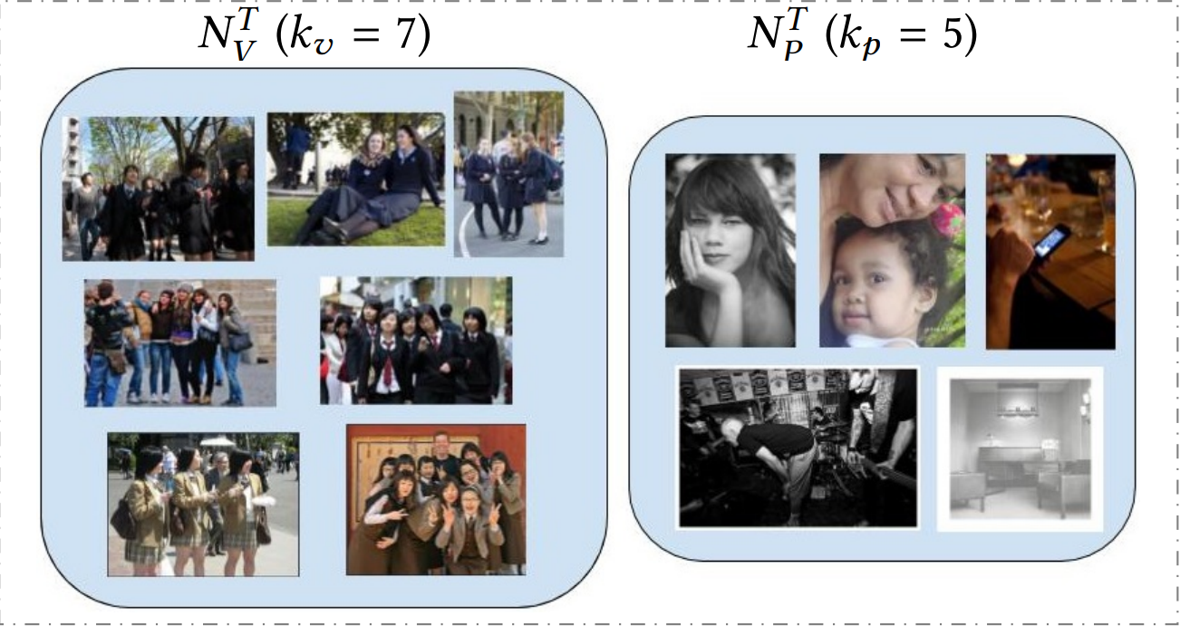
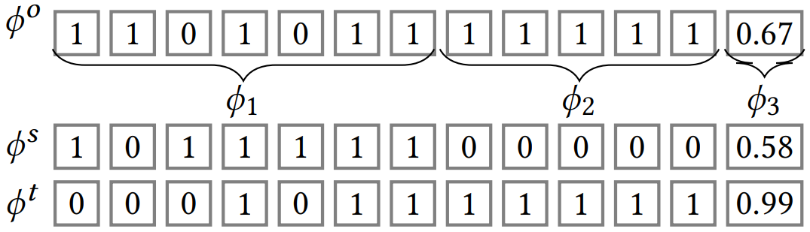
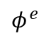
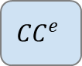
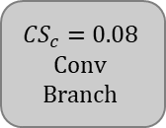
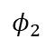
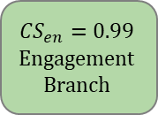
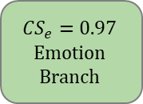
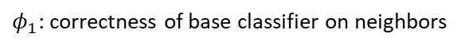
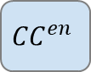
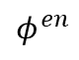
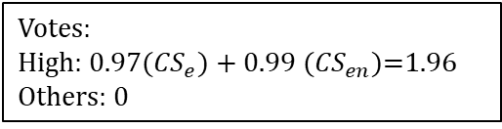
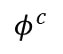
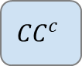
Model Description
Neighborhood
Voting mechanism
Unsupervised training of the CC, adapted from the paper Dynamic Deep Multi-modal Fusion for Image Privacy Prediction (Tonge, Caragea, 2019).
Instead of detecting attributes present, each stream directly predicts the interaction level.
Competence score is used as a binary indicator (threshold 0.5) instead of weights.
$${CC}^{e}$$
$${CC}^{c}$$
$${CC}^{en}$$
$${CS}_{e}=0.97$$
Emotion Branch
$${CS}_{c}=0.08$$
Conv Branch
$${CS}_{en}=0.99$$
Engagement Branch
Target Episode
Competent base classifiers are selected
$$φ^{e}$$
High
High
Competence feature
$$φ_{2}$$
Votes:
High: 0.97(${CS}_{e}$) + 0.99 (${CS}_{en}$)=1.96
Others: 0
$$φ^{c}$$
$$φ^{en}$$
Majority Vote: High
$φ_{1}$: correctness of base classifier on neighbors
$φ_{2}$: confidence of base classifier on target sequence
Notes:
Here’s a detailed explanation of how the competence classifier is trained and how the voting is done to get the final prediction. Firstly, given an episode, we’ll obtain the neighborhood using cosine similarity. From the neighborhood we’ll generate the input to competence classifier. This competence feature consists of two parts. The first part is the correctness of base classifier on the neighbors. It’s obtained by running base classifiers on neighbors. The second part is the confidence score of base classifiers on the target sequence. The competence vectors will be fed into competence classifiers to compute the competence scores. Only if the score is above 0.5, the branch will be considered as competent and we’ll use the predicted labels for voting. In the example here, emotion and engagement classifiers are both competent and predicting a high interaction level. Thus, the final score for high is 0.97+0.99 = 1.96, leading to a final prediction of high. Both this variant and the proposed model are scalable where we can add in other modalities if we find them significant. The advantage of the proposed model is it fully utilized the annotation while this variant doesn’t require extra data to train the competence classifier. We’ll run more experiments and compare their performance in the future.

Slide 17
Face Tracking (Seq Detector) Pipeline
Each face sequence
List of Bounding Boxes
DeepFace Face detector
For each BB
Raw Input frames
(Episode)
Crop Face
Person ID
To separate individuals from episodes and generate bbox.
Tried Methods
Video Geometry Group Face Tracker
OpenCV-dlib Trackers
Problem with previous methods
Unable to track low fps
Very laborious to do manually
If similar
DeepFace Face Similarity
If dissimilar
Assign Person ID
FaceDB
DeepFace by Facebook Research
Notes:
This is the face tracking pipeline we designed specially for our dataset. As mentioned earlier, we need to separate person sequences from episodes and generate bounding boxes. To achieve this goal, we have
tried two methods: VGG face tracker and OpenCV-dlib Trackers. However, both methods are designed for high frame rate videos and failed on our dataset due to low frame rate. And to do is manually would be too laborious. Thus, we designed a very simple and intuitive but highly efficient pipeline using DeepFace API.
First, given an episode of raw input frames, we feed them 1-by-1 into DeepFace Face detector to generate a list of bounding boxes for each face. Then for each bbox, we crop out the face region from raw frames and send it to DeepFace Similarity engine to assess similarity against a FaceDB. If the new face crop exists in the database, we’ll append it to the particular sequence. Otherwise, we’ll assign an ID to the new face and update the database with this new entry.

Slide 18
Thank You!

Slide 19
Supplementary Materials
Performance summary for different subsets of modalities as input features. Test results on Zip31.
Modalities | Test Accuracy | Macro Avg Precision | Macro Avg recall | Weighted F1
All | 94.6 | 0.909 | 0.935 | 0.949
- social, part, brief | 91.7 | 0.875 | 0.917 | 0.923
- social, part, emo | 95.1 | 0.915 | 0.951 | 0.953
- social, part, eng | 95.0 | 0.916 | 0.941 | 0.951
- social, part, conv | 92.8 | 0.888 | 0.922 | 0.932
- social, part | 95.8 | 0.925 | 0.959 | 0.960
- part, conv | 90.6 | 0.865 | 0.891 | 0.911
- part, emo | 93.7 | 0.899 | 0.941 | 0.941
- part | 93.8 | 0.900 | 0.930 | 0.941
Notes:
convo > emo > eng
brief > emo > eng
And social negatively affects the performance.

Slide 20
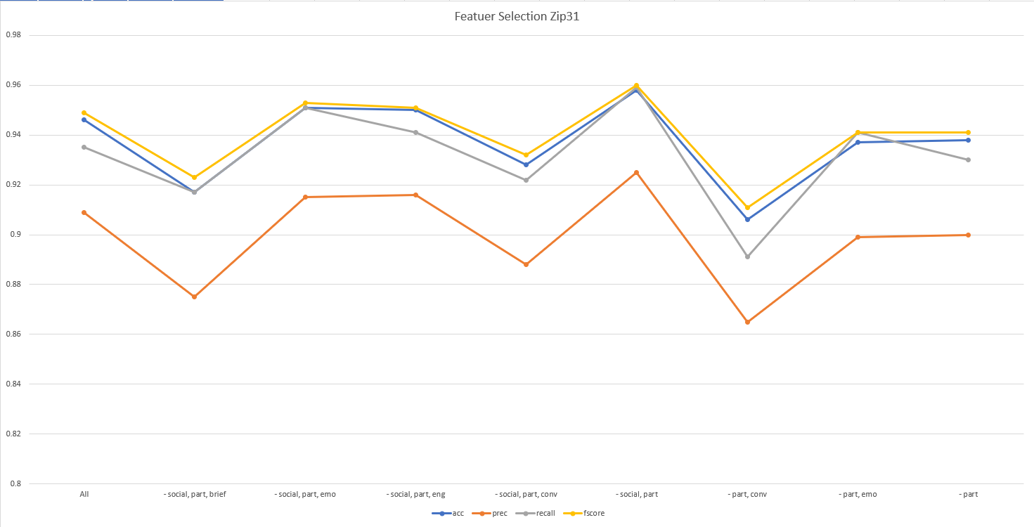
Performance Summary Zip31

Slide 21
Supplementary Materials
Performance summary for different subsets of modalities as input features. Test results on Zip15.
Modalities | Test Accuracy | Macro Avg Precision | Macro Avg recall | Weighted F1
All | 99.0 | 0.987 | 0.984 | 0.990
- social, part, brief | 95.8 | 0.963 | 0.932 | 0.957
- social, part, emo | 99.1 | 0.989 | 0.992 | 0.992
- social, part, eng | 99.3 | 0.989 | 0.996 | 0.993
- social, part, conv | 98.2 | 0.973 | 0.974 | 0.982
- social, part | 99.2 | 0.987 | 0.993 | 0.992
- part, conv | 98.4 | 0.979 | 0.971 | 0.984
- part, emo | 98.8 | 0.982 | 0.986 | 0.988
- part | 98.9 | 0.982 | 0.988 | 0.989

Slide 22
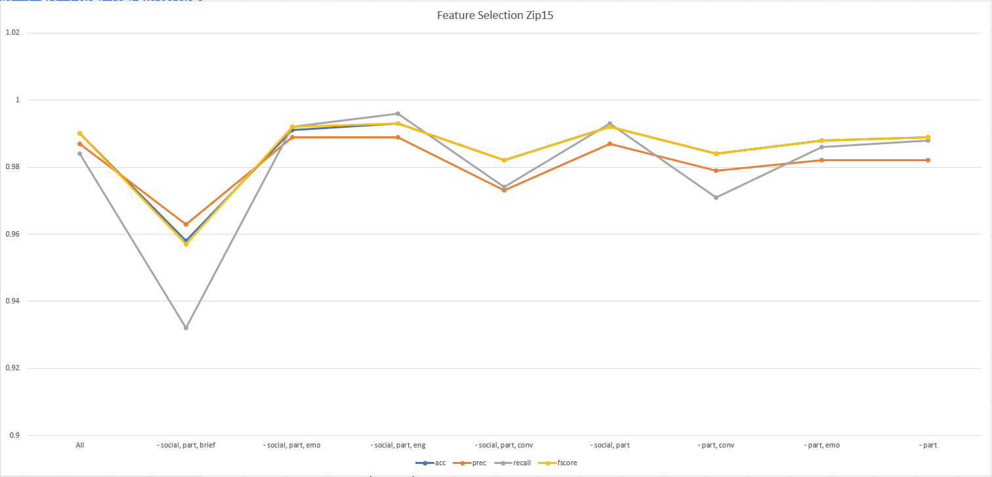
Performance Summary Zip15

Slide 23
Candidates for Feature Extracting Models
Emotion feature:
https://github.com/WuJie1010/Facial-Expression-Recognition.Pytorch
https://github.com/oarriaga/face_classification
https://github.com/AmrElsersy/Emotions-Recognition
https://github.com/DenisRang/Combined-CNN-RNN-for-emotion-recognition
https://www.kaggle.com/c/challenges-in-representation-learning-facial-expression-recognition-challenge/code
Engagement feature:
https://github.com/omidmnezami/Engagement-Recognition
https://towardsdatascience.com/transfer-learning-with-convolutional-neural-networks-in-pytorch-dd09190245ce

